Slide 1
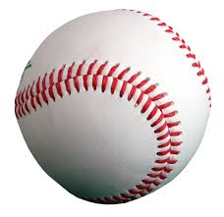



Vital Statistics of Professional Athletes
Eric Kuo
General Assembly
Capstone Project

Slide 2
Problem Statement
What impact does a career in professional sports have on the life expectancy of an athlete?
According to Wikipedia article about Football Players:
The average life expectancy or lifespan of an American football NFL player has been reported to be extremely low, only 53 to 59 years depending on playing position.
However, a 2012 study reported that retired NFL players have a lower death rate than men in the general population.

Slide 3
Some Ways To Answer That Question…
Can we build a model to predict how many athletes will die in a given year?
How does the distribution of ages at death of athletes compare to that of the general population?
Of athletes who were born in a certain time period, can we predict whether they are still alive, or how long they lived based on the length of their playing careers or their physical dimensions?

Slide 4




Collecting Player Data
Player data was collected from the following sites:
From each site, data was collected (or inferred) about each player:
Date of birth and death
Age at death
Length of career: number of seasons and games played
Height and weight (for selected baseball and football players)

Slide 5


Vital Statistics of General Population
Life expectancy tables from 2004 to 2015 were collected from the Social Security Administration
Number of annual live births in the United States were taken from the Center of Disease Control and Prevention

Slide 6
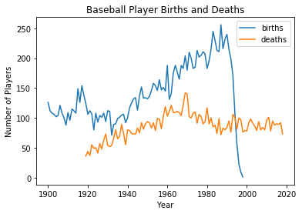
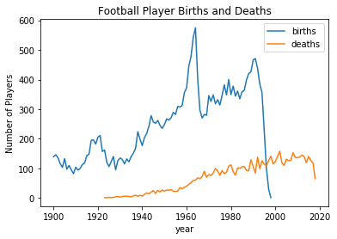
Annual Number of Births and Deaths of Professional Athletes
Replacement Players
During 1987 strike

Slide 7
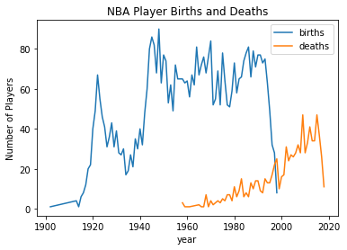
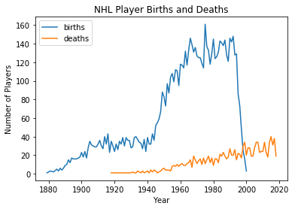
Annual Number of Births and Deaths of Professional Athletes

Slide 8
Modeling Number of Athlete Deaths in a Particular Year
Example: how many NBA players will die in 2015?
For each year in the 2015 SSA Life Table, estimate percentage of males who were born that year that will die in 2015
Example: roughly 3.5% of males born in 1930 will die in 2015
Multiply that estimated percentage by the number of athletes who were born in that year to get expected number of athletes who will die at that age
Of the 39 players born in 1930, about 0.035 * 39 = 1.365 will die in 2015
Sum up the expected number of deaths for each birth year to get total expected number of athlete deaths in 2015
For NBA players 2015, expected number is 43.9 deaths. In actuality, 47 players died.

Slide 9
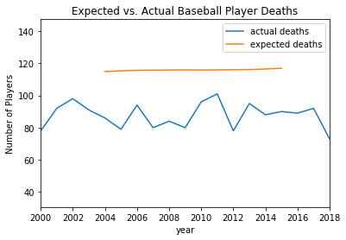
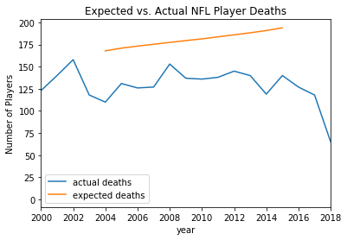
Predicted vs. Actual Number of Deaths

Slide 10
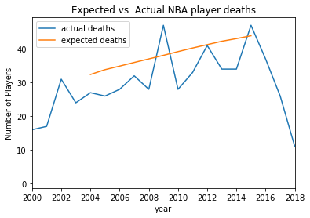
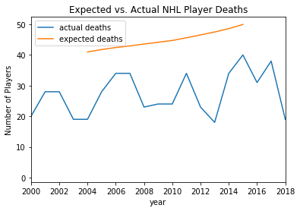
Predicted vs. Actual Number of Deaths

Slide 11
Comparison of Distributions of Ages at Death
Conduct an A/B test between two population samples to determine how likely their ages at death are from same distribution
First group: all athletes of a particular sport who died in a particular year
Second group: general population of American males who died in a particular year
For NBA, NHL, and NFL athletes, A/B test did not reveal any conclusive differences between the athletes’ ages at death with those of the general population
One exception: NHL player deaths in 2011
However, for Major League Baseball players, the A/B test revealed a difference between their age distribution and that of the general population

Slide 12
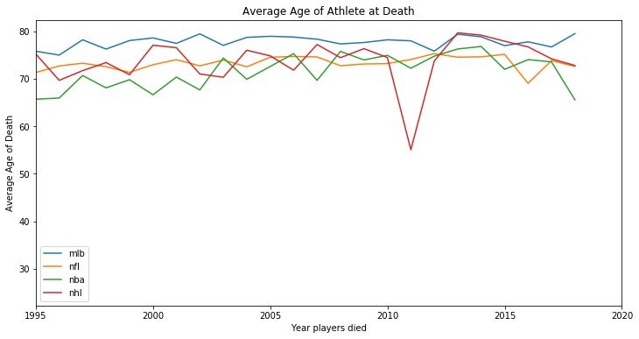
Average Age at Death of Pro Athletes
2011 Lokomotiv Yaroslavl
Plane crash

Slide 13
Attempt at Classification
Of all Major League Baseball players who were born between 1930 and 1945, 42% are deceased
Can we build a classification model to predict whether a player is still alive?
Based on length of career, numbers of games played, listed height and weight, no classification model achieved over 60% accuracy
As it turns out, no correlation between any of those characteristics with whether a player is still alive, or how long a player lived
At best, a slight (and obvious) correlation exists with the year of birth and how long a player lived

Slide 14
Conclusions
Prediction of number of athlete deaths works reasonably well for NBA players, but consistently overestimates for the other sports (MLB, NFL, NHL).
Distribution of ages at death is not significantly different from the general American male population for NFL, NBA, or NHL players
However, Major League Baseball players seem to have higher life expectancies than players in other leagues
No correlations exist between life expectancy and length of playing career, or even physical dimensions of professional athletes

Slide 15

Life expectancy of NFL players is 59 years?

